Slide 2
3D blade model updating by coupling HAWC2 and ABAQUS
Maria Luz Castilla Mena (s212601@dtu.dk)
Notes:
Hi, I am Maria and I am going to present my master thesis topic: Evolution of blade cracks with wind turbine simulation tolos (this is a provisional titile, it needs to be discussed)

Slide 3
Doubts 3rd October

Slide 4
Doubts
MATLAB code: .inp ABAQUS files regarding change of amplitude in each restart job
Wind profiles: long simulations
Regarding HAWC2
Strains in HAWC2?

Slide 5
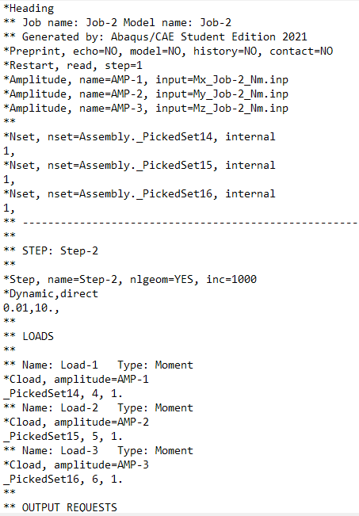
.inp files
Problems:
In each job, the moments need to be applied to a different “_PickedSet”
I need to use different amplitude names

Slide 6
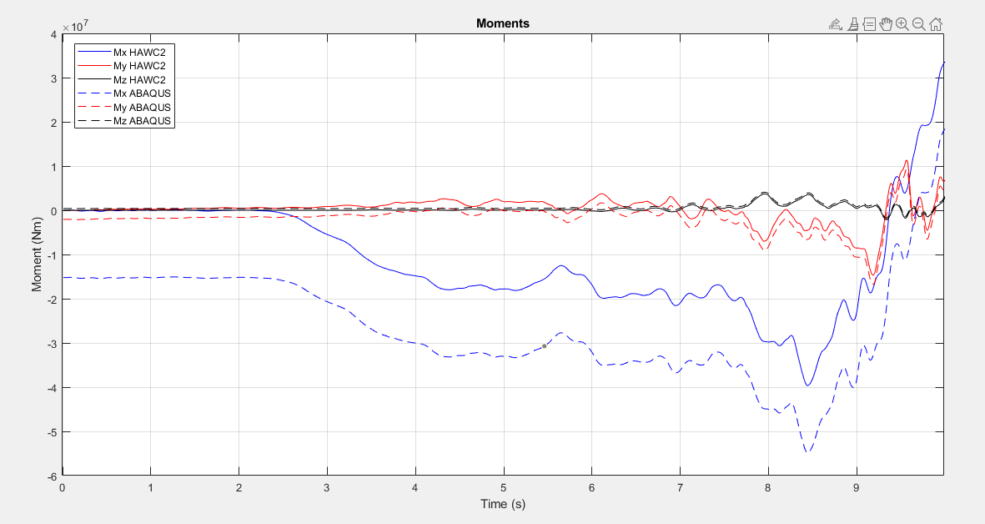
Different amplitude names
Offset due to the previous job:
the last value remains constant in the next job

Slide 7
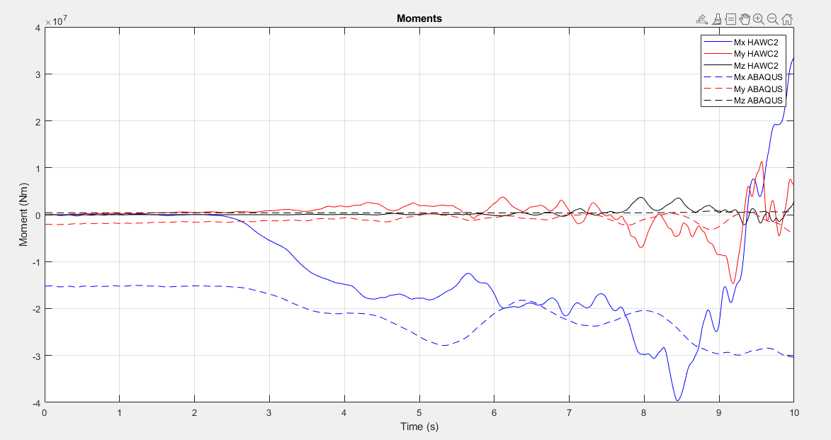
Same amplitude names

Slide 8
Wind profile
I find hard to find wind profiles. Have been doing research, no information found.
What should I try?
Link sent by Ju:
Only able to download one piece of data
1800 seconds time series = 3hours long in HAWC2

Slide 9
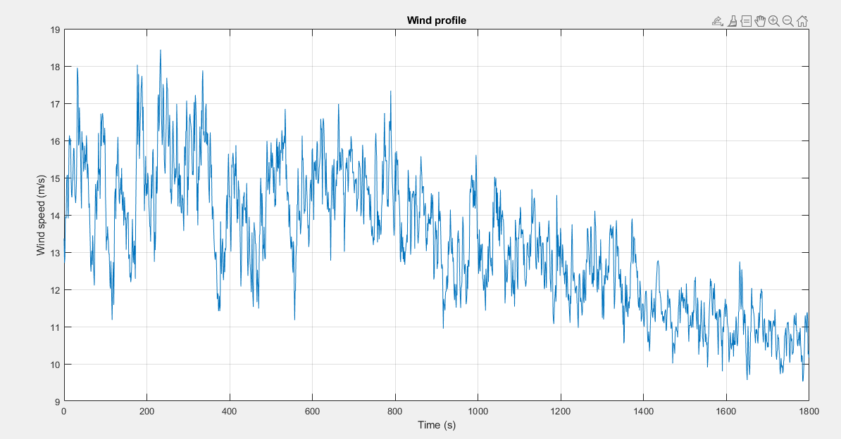

Slide 10
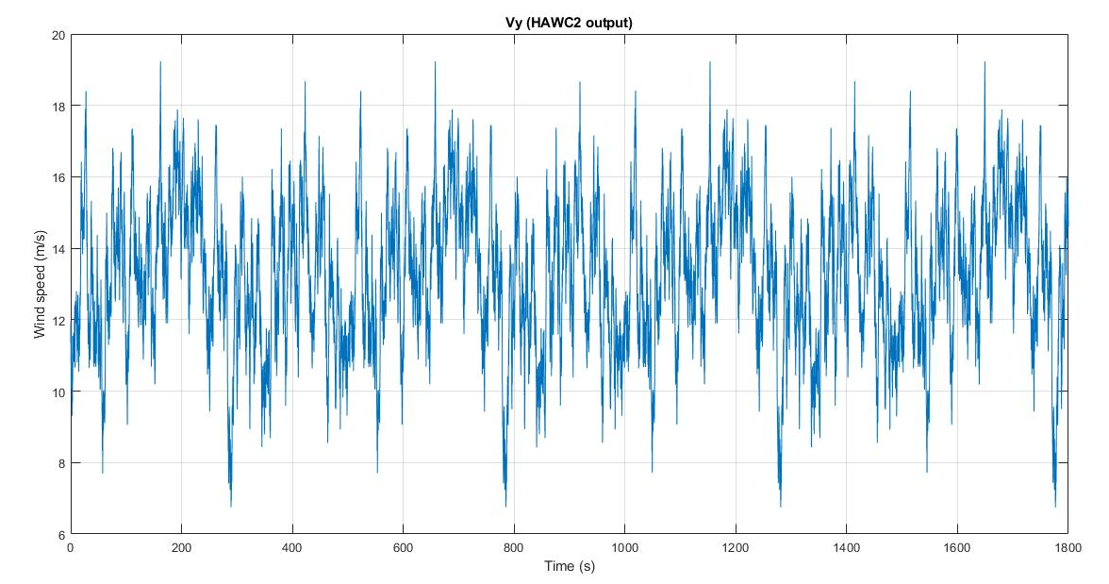
3h long to generate!!

Slide 11
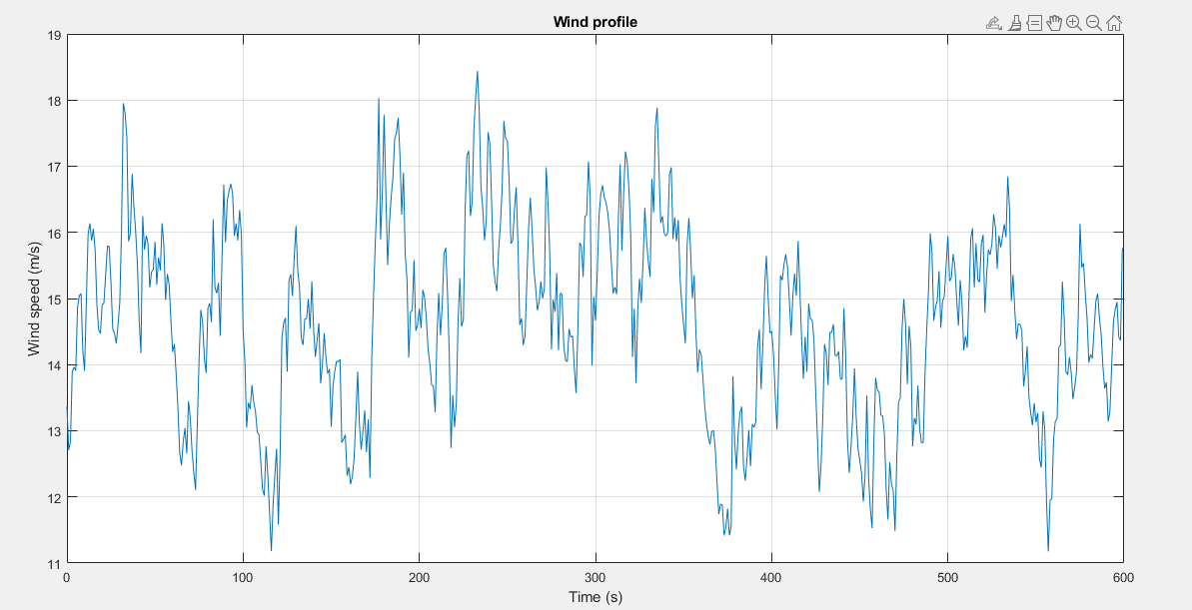

Slide 12
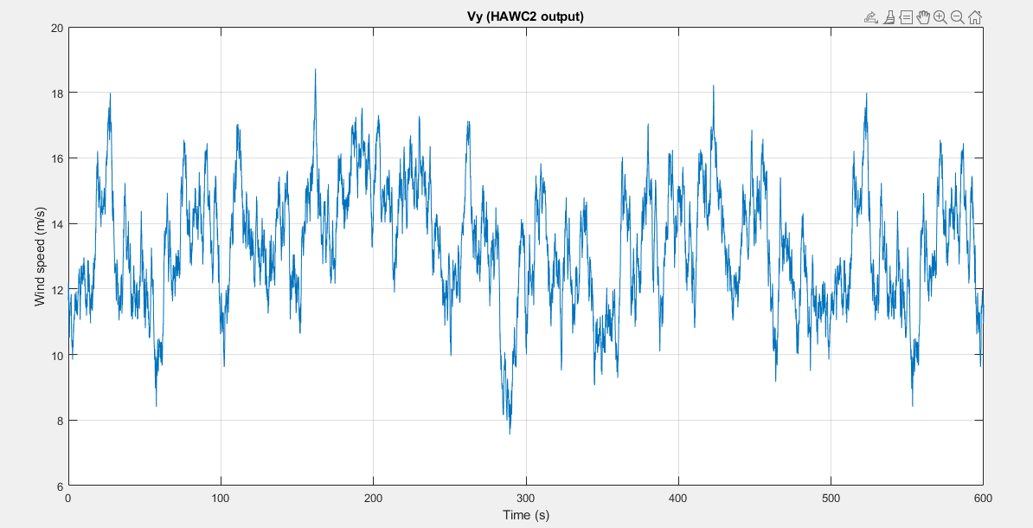
Since data is for 1800 sec:
- For 600sec, the mean wind speed is not the same. The standard deviation neither…

Slide 13
Wind profile replication
Modified:
Turbulence intensity (=standard deviation/mean wind speed)
Turbulence parameters I think not needed to be modified
To modify:
Try changing shear parameters and see the difference

Slide 14
Regarding HAWC2 doubts

